Slide 1
Logic Circuits
Cira Vlad-Stefan

Slide 2

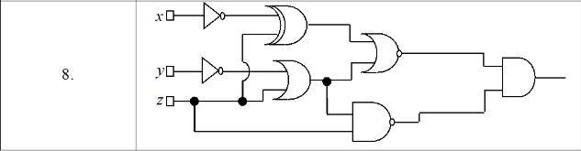
Exercise 1.8

Slide 3
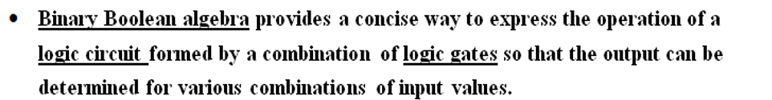

Logic Circuits

Slide 4
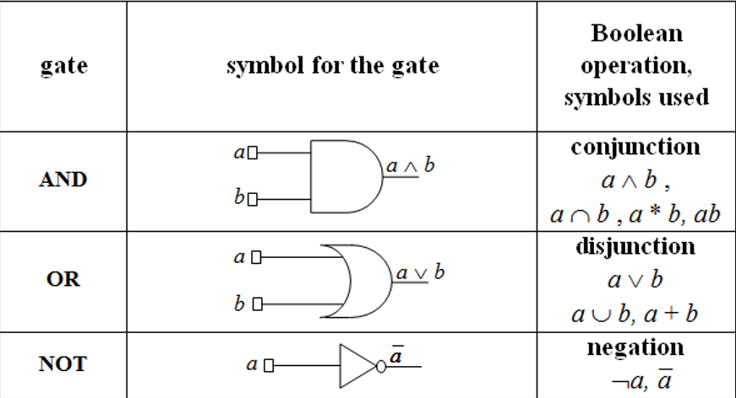
Basic Gates – IEEE Standards
IEEE, pronounced "Eye-triple-E," stands for the Institute of Electrical and Electronics Engineers.

Slide 5
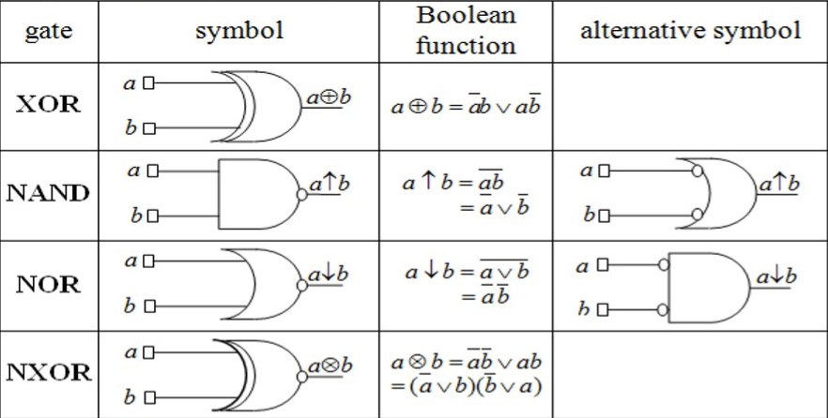
Derived Gates – IEEE Standards
IEEE, pronounced "Eye-triple-E," stands for the Institute of Electrical and Electronics Engineers.

Slide 6
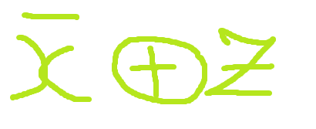

Slide 7
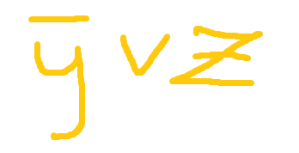

Slide 8
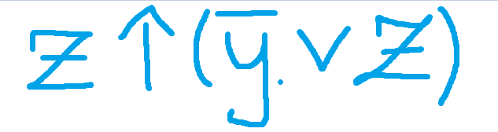

Slide 9
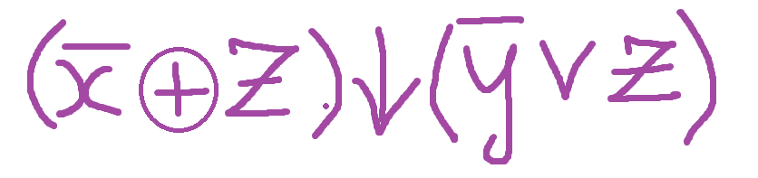

Slide 10
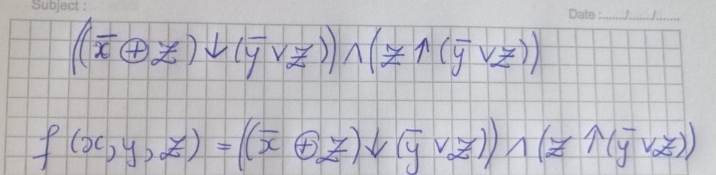
The logic circuit has its’ corresponding Boolean function
as shown below

Slide 11
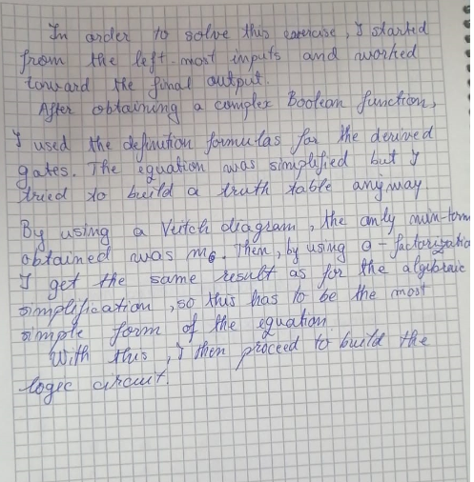

Slide 12


I begin to simplify the equation so that it has only basic gates
By using this rule, I rewrite the equation

Slide 13
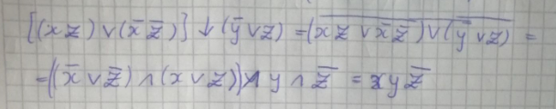
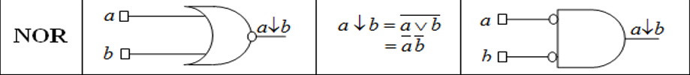
I start to move on from left-to-right in the equation
By using this rule, I rewrite the equation

Slide 14

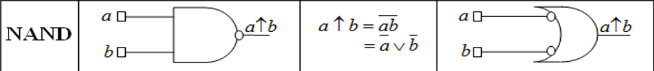
I start to move on from left-to-right in the equation
Last but not least, this is the last equation to be simplified

Slide 15
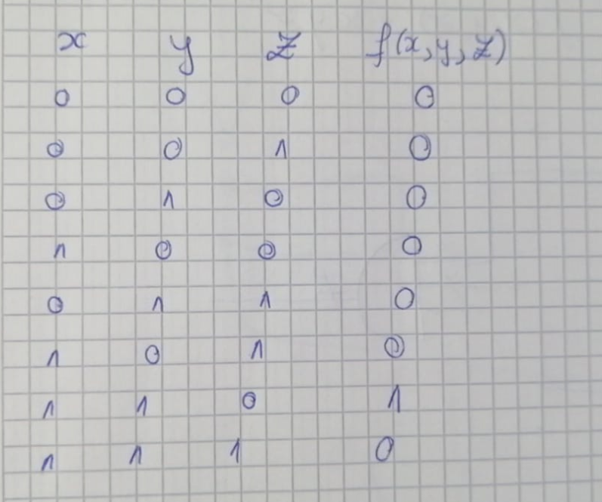
This is the truth table that resulted

Slide 16
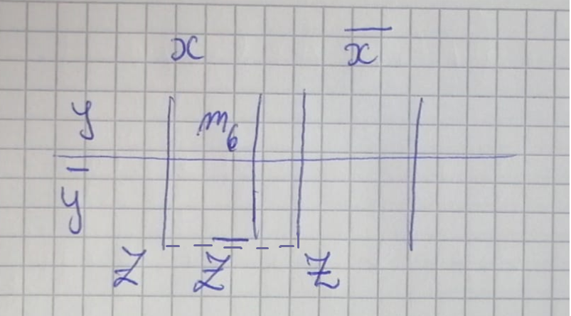
This is the Veitch diagram with the corresponding min-terms

Slide 17
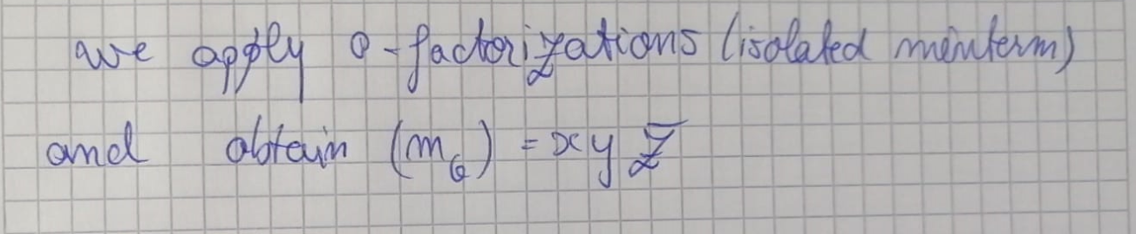

Slide 18

After simplification, this is the result

Slide 19
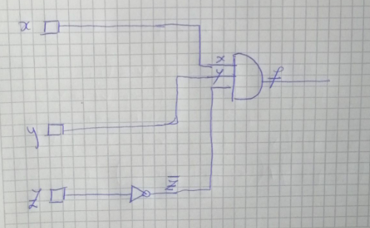
With the simplified Boolean function, I begin representing the logic circuit

Slide 20
Thanks for paying attention

